Slide 1
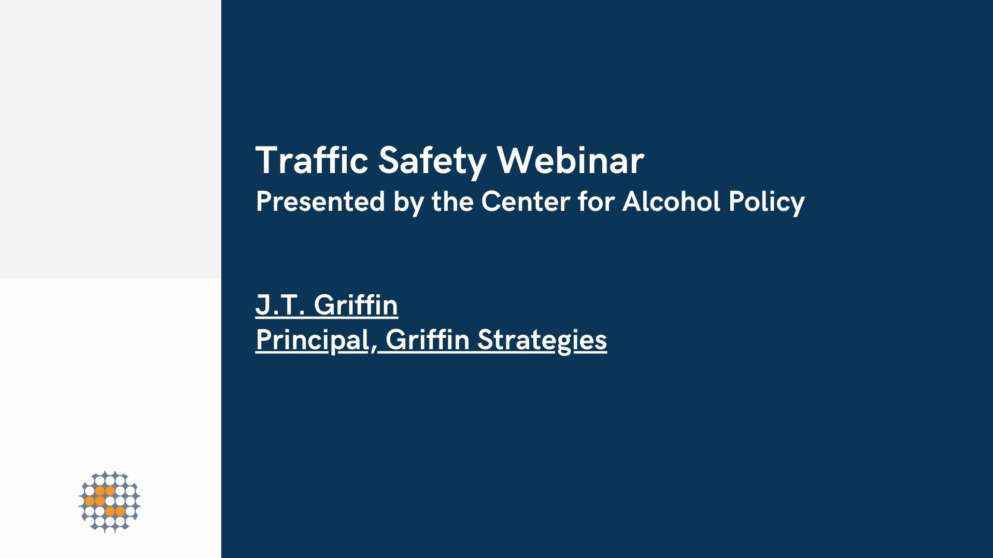

Slide 2
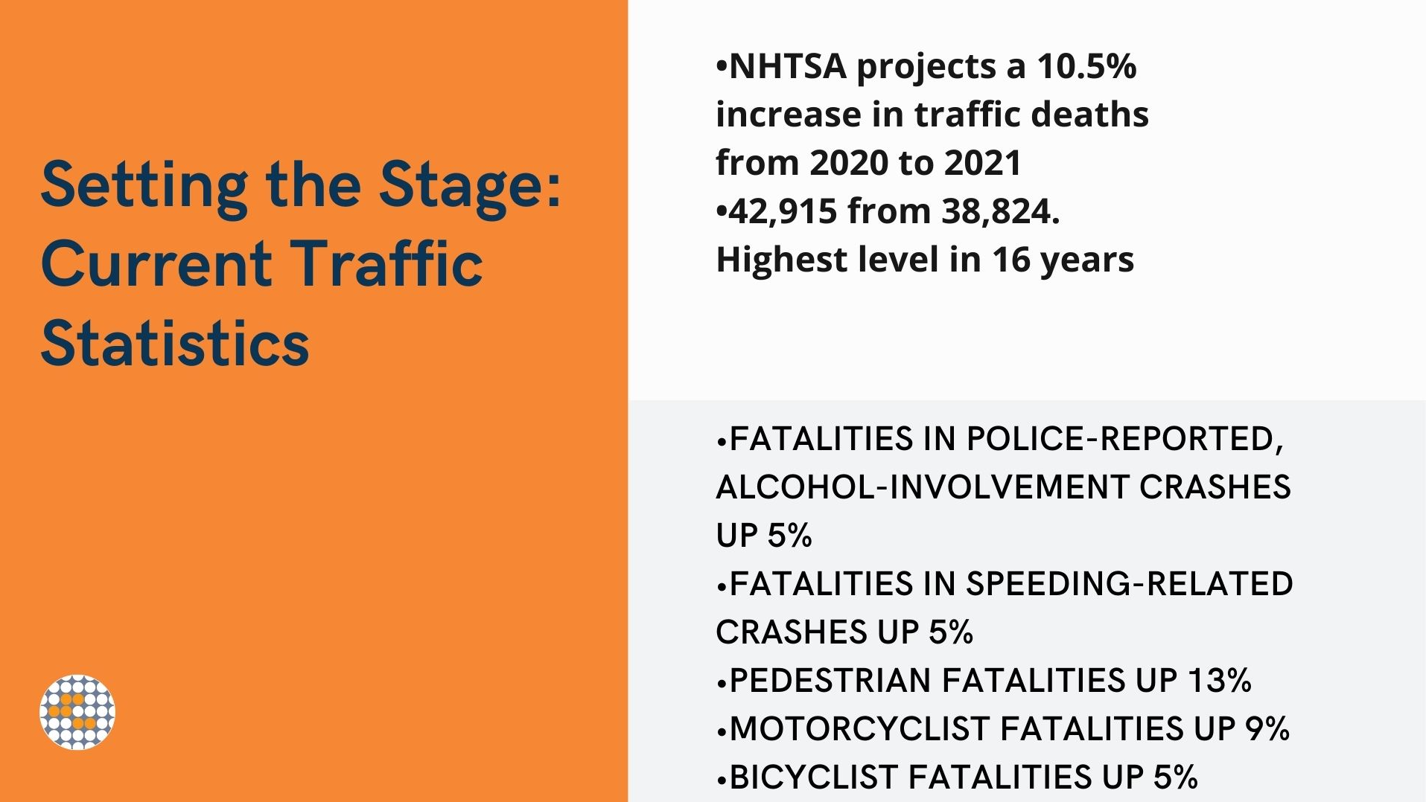

Slide 3
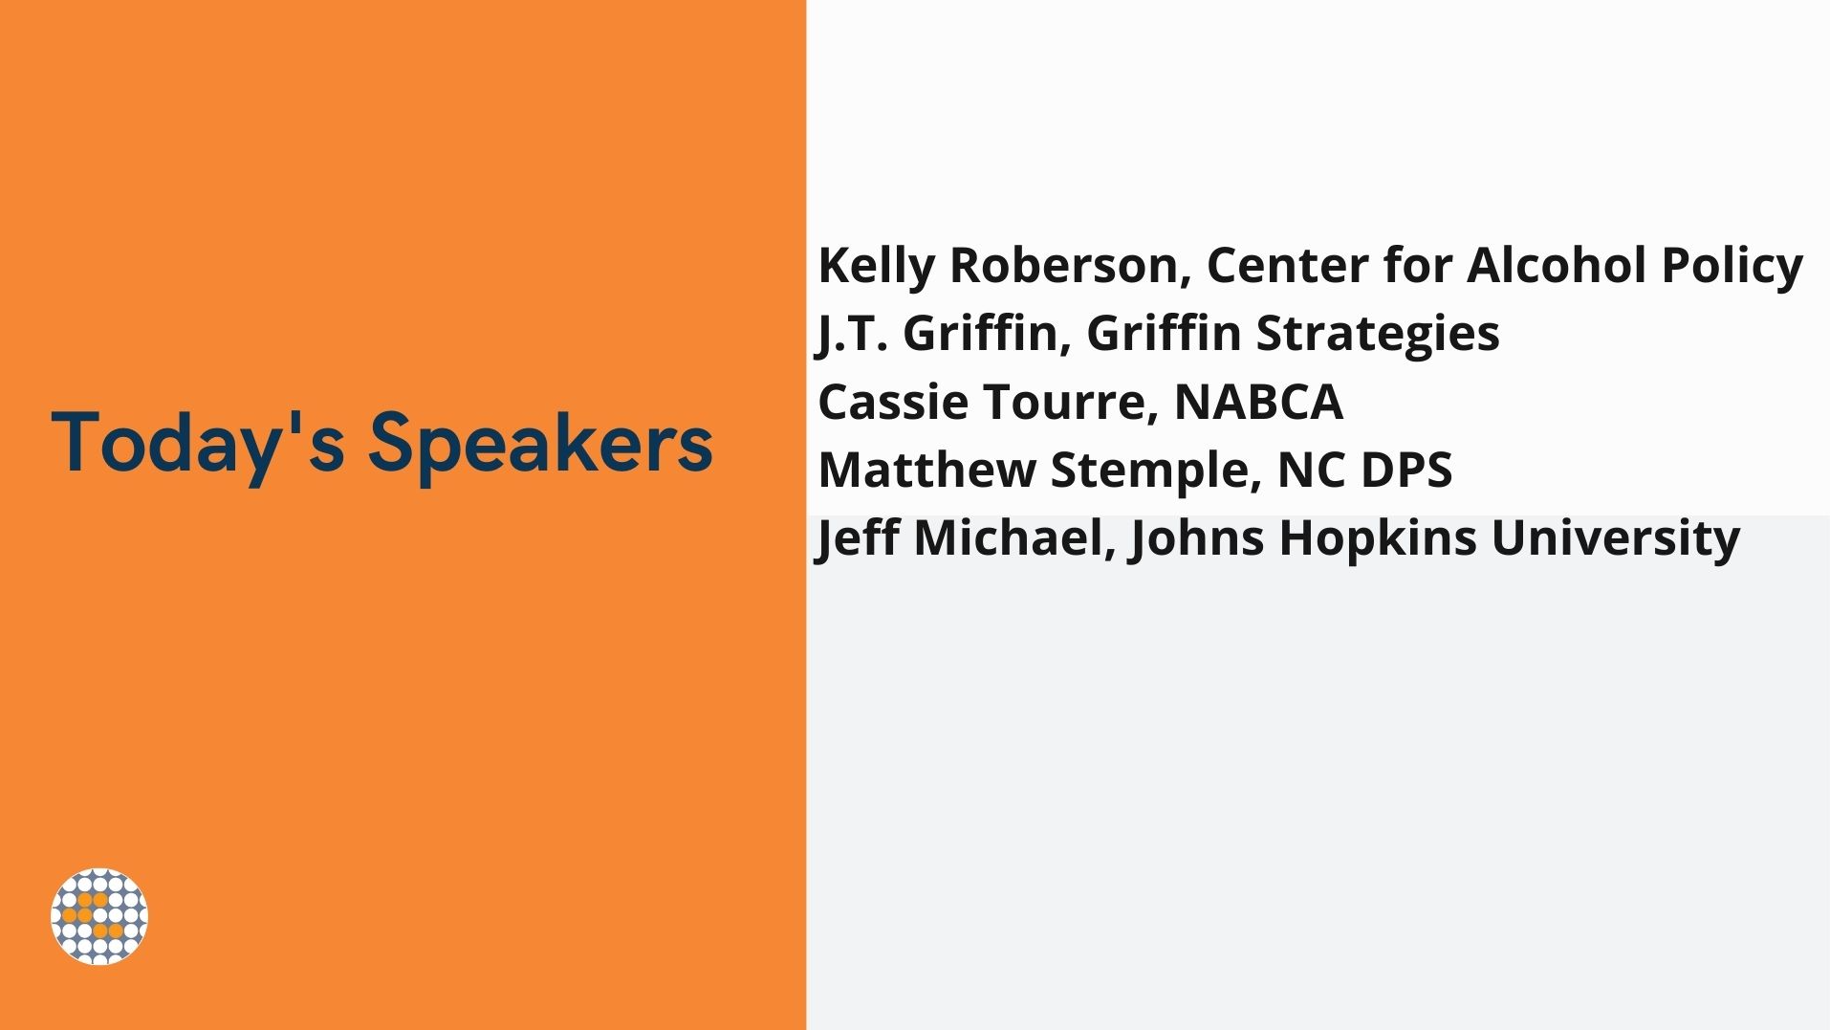

Slide 4
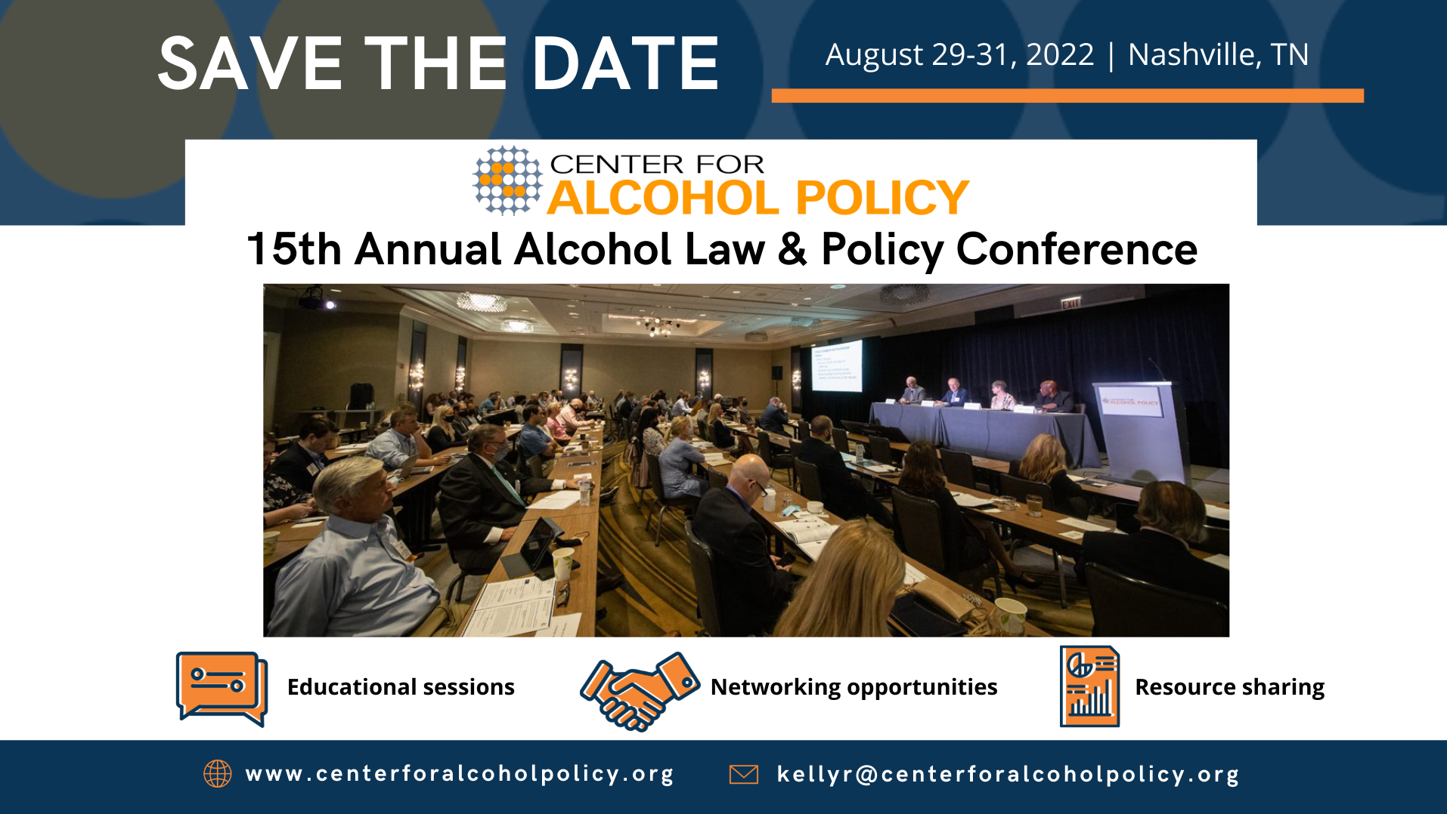

Slide 5
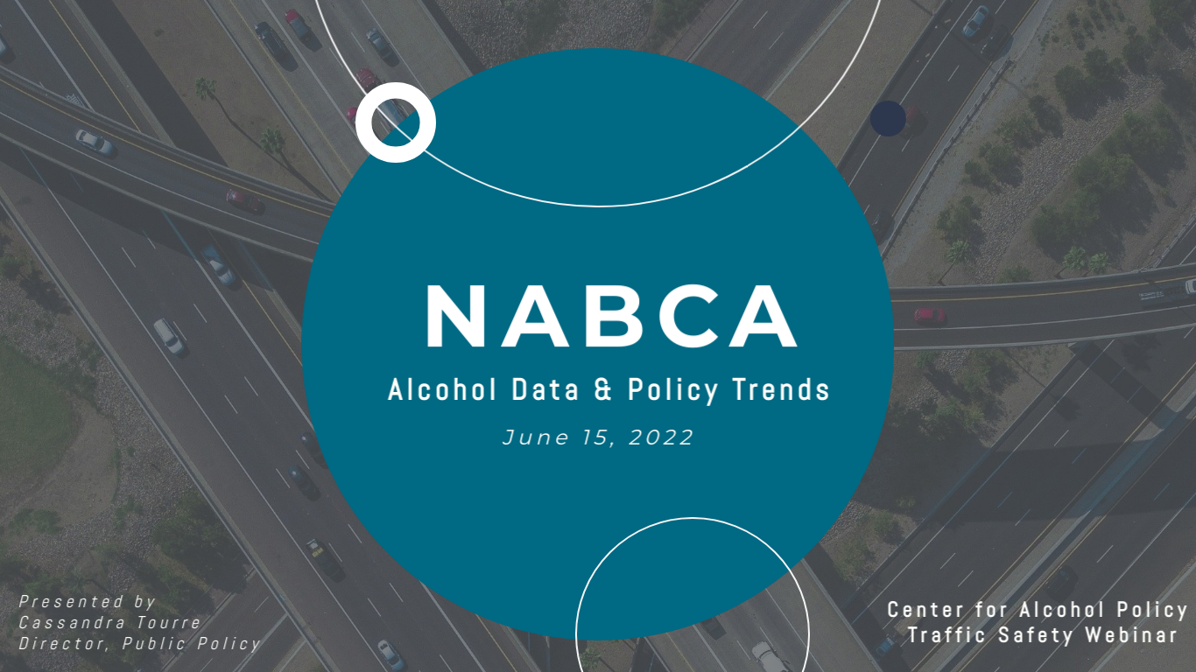

Slide 6
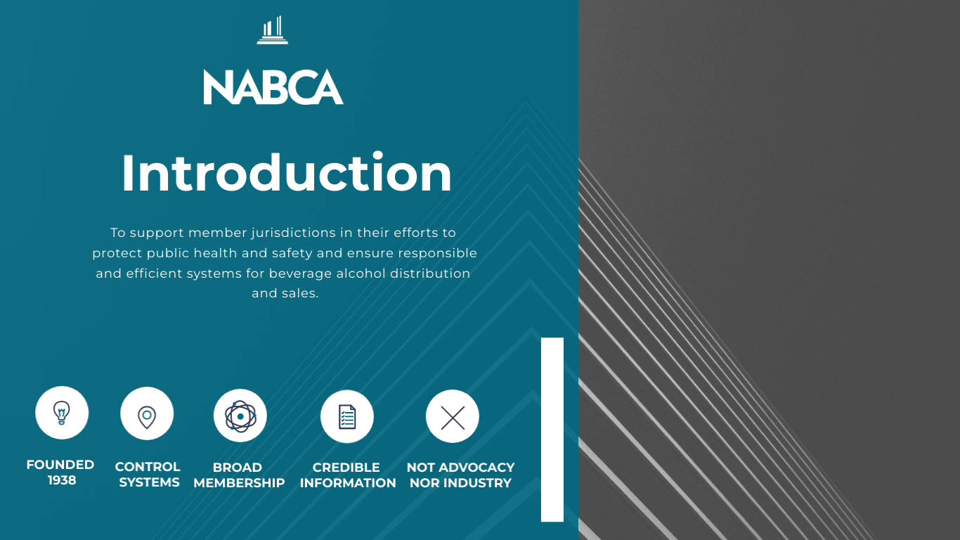

Slide 7
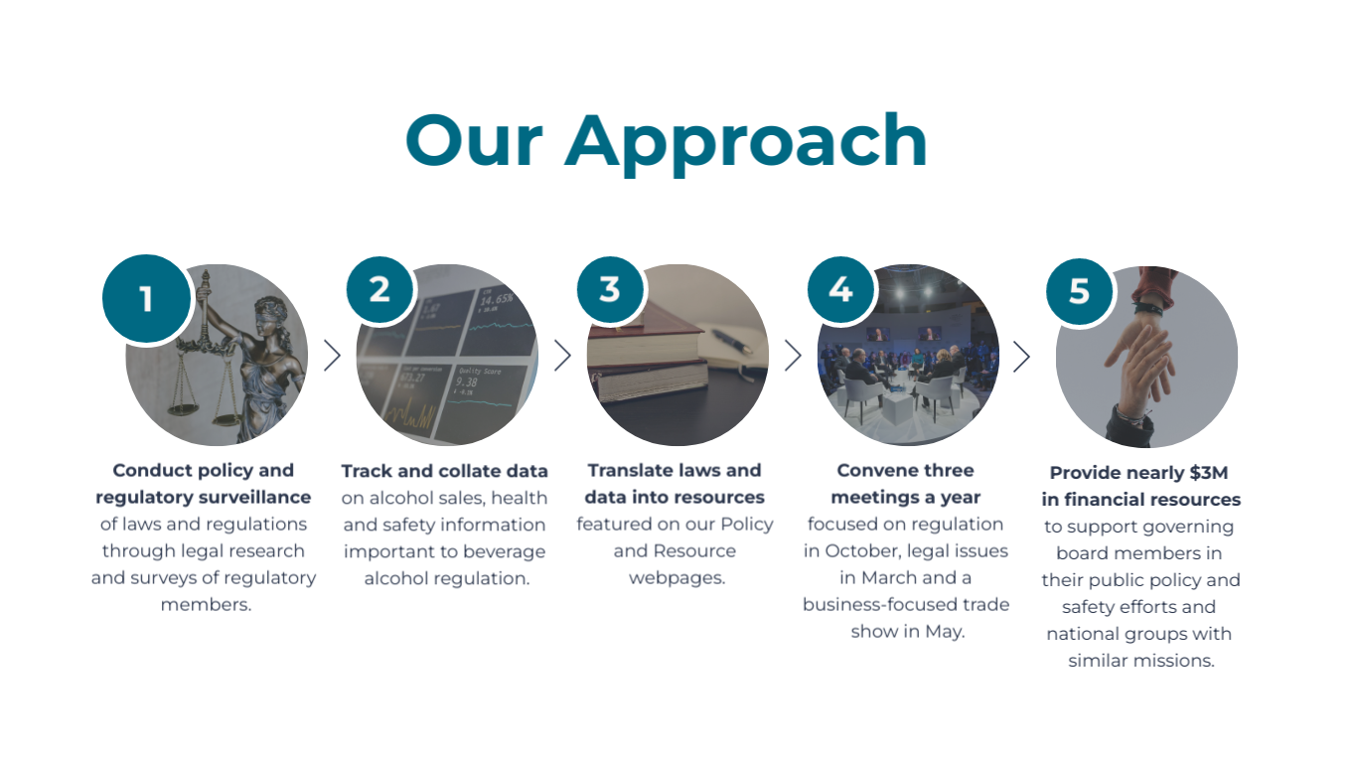

Slide 8
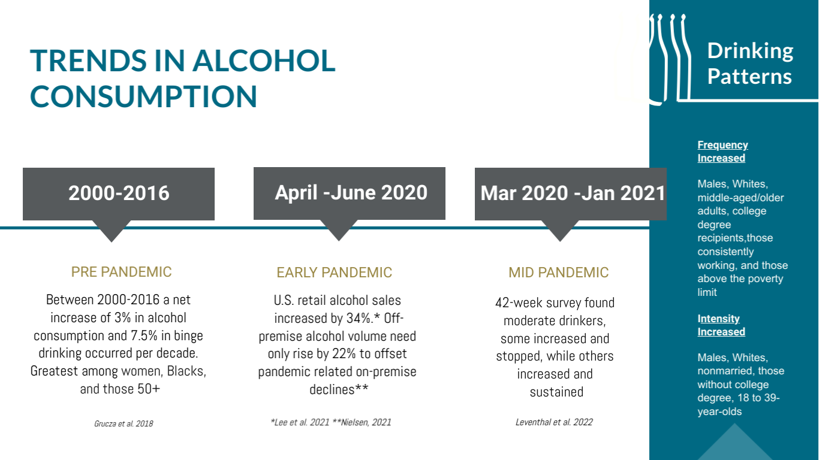

Slide 9
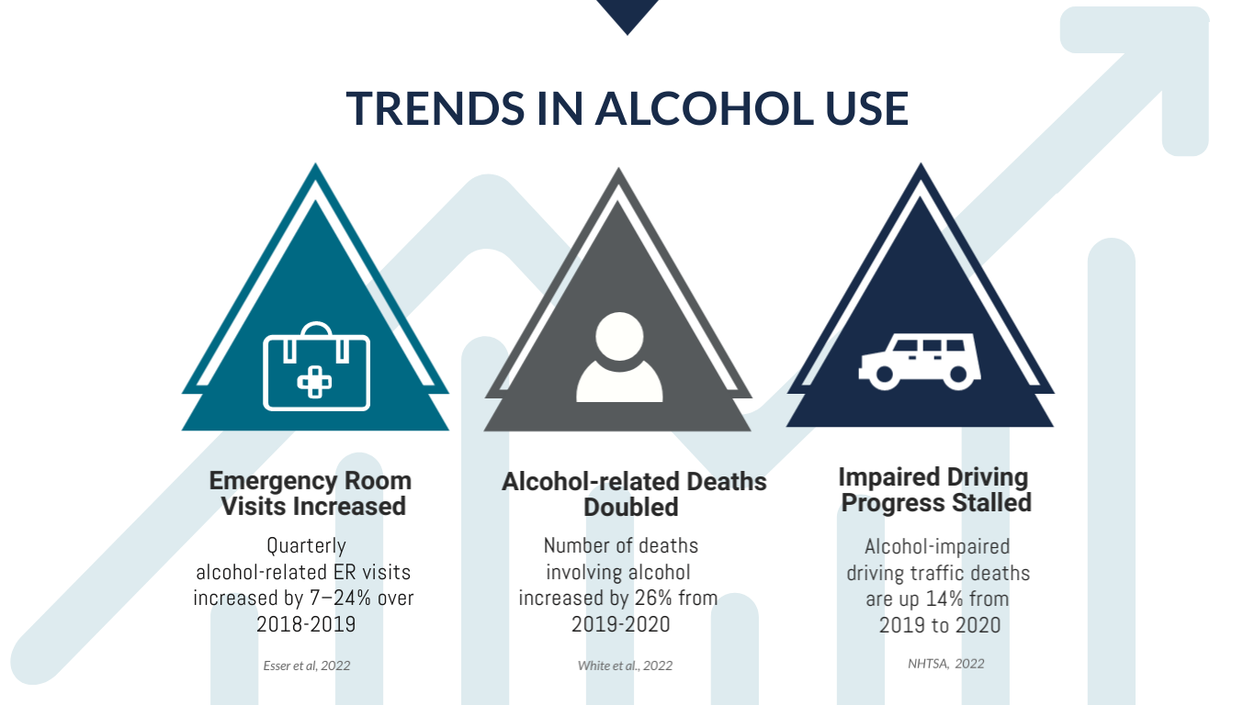

Slide 10
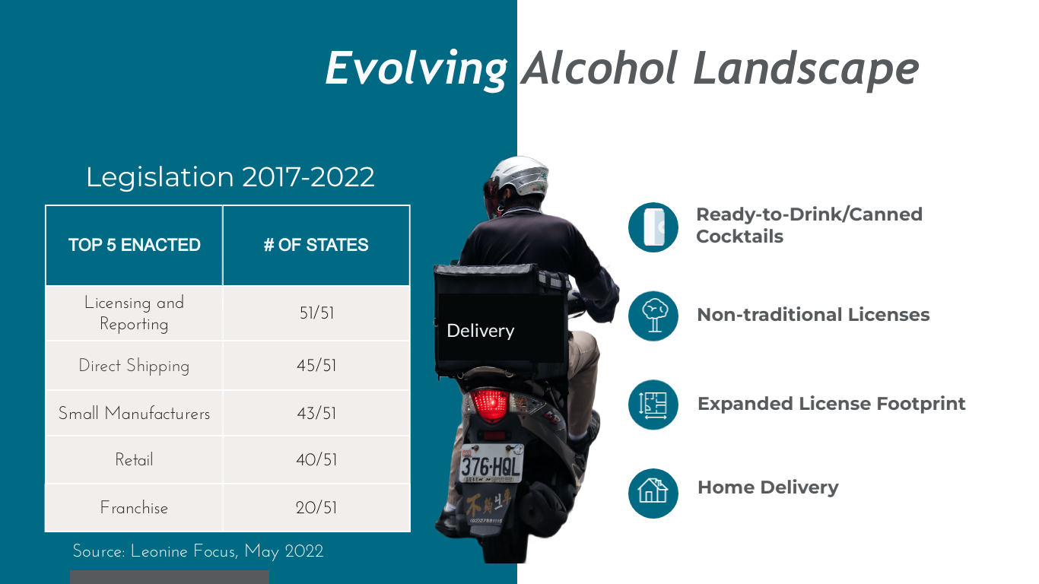

Slide 11
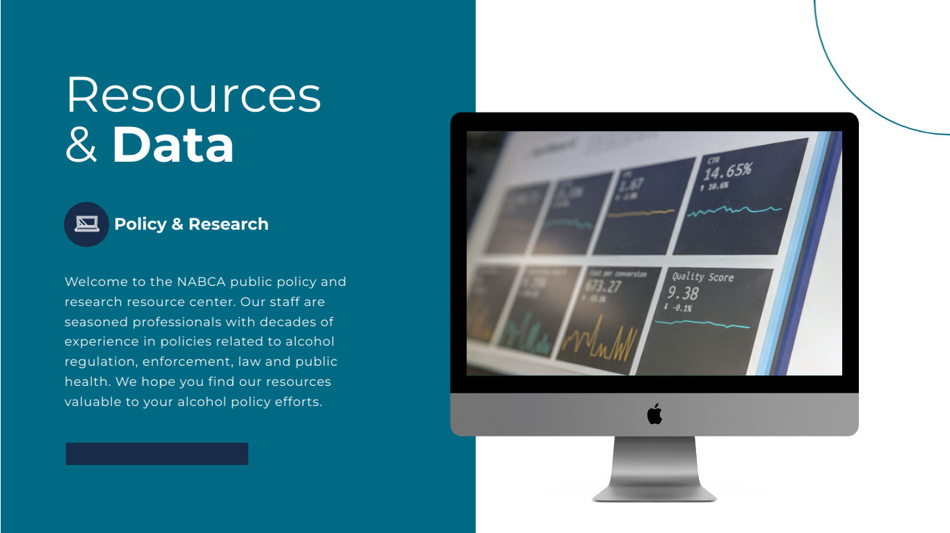

Slide 12


Slide 13
North Carolina Alcohol Home Delivery Compliance Check Study (2018-2019)
Matt Stemple
Assistant Special Agent in Charge
North Carolina Alcohol Law Enforcement

Slide 14
Objective
The objective of this operation was to conduct compliance checks on alcohol delivery services in North Carolina to determine sale to underage rates of each delivery service and of alcohol delivery services as a whole.

Slide 15
Methods: Sample
From September 2018 to January 2019, North Carolina Alcohol Law Enforcement (ALE) Special Agents conducted eighteen (18) alcohol compliance checks on alcohol delivery services. The compliance checks were conducted in the greater Charlotte and greater Raleigh areas of North Carolina.

Slide 16
Methods: Buyers
Depending on their availability, one of two underage persons were used to complete the compliance checks. One underage person was a youthful appearing, 19 year old, white male. The other underage person was a youthful appearing, 18 year old, white male. The 19 year old male was used in four (4) of the 18 compliance checks. The 18 year old male was used in 14 of the 18 compliance checks.

Slide 17
Methods: Procedures
Before scheduling the operations, research was conducted on apartment complexes in the greater Charlotte and greater Raleigh areas to check for vacancies and to ensure alcoholic beverages could be delivered in less than one (1) hour by each of the selected delivery services.
Prior to beginning the compliance check operation, the underage person’s identification was examined and it ensured the underage did not possess a fictitious identification. The underage persons were instructed to present their identification if requested by the courier and to answer all questions truthfully.
Orders were placed for malt beverages online through Instacart, Postmates, Amazon, and Drizly’s websites. If presented with an age verification prompt, a fictitious date of birth was entered to ensure an attempted delivery was made.
Notes:
Drizly is a website that connects the customer to a retailer. The retailer fulfills the order and makes the deliveries themselves.

Slide 18
Methods: Procedures
After each purchase attempt was complete, all couriers were interviewed. Data gathered from the couriers included: name, age, sex, and prior experience working as an employee of an alcoholic beverage retailer in North Carolina. For the purposes of this study, an individual was considered working as an employee of an alcoholic beverage retailer if they had retail experience selling alcoholic beverages by working in a traditional brick and mortar ABC permitted establishment such as a convenience store, grocery store, restaurant, or bar/night club which held ABC permits under North Carolina General Statute 18B-1001.
Although Amazon has brick and mortar establishments in Charlotte and Raleigh, which hold ABC permits under the trade name “Prime Now” or “Amazon Fresh”, employees of Amazon were not considered to have experience working in a retail alcoholic beverage setting. Amazon’s business model is as a delivery service, not as a walk-in retail establishment. Amazon employees were only considered to have had experience working in an alcoholic beverage retail environment if they had worked for another ABC permitted establishment in North Carolina which fit the requirements in the above paragraph.

Slide 19
Methods: Procedures
After each interview was completed, the couriers were informed of the four acceptable forms of identification, pursuant to North Carolina General Statute 18B-302(d)(1), and reminded not to sell or give alcoholic beverages to underage and intoxicated individuals. If the courier completed the transaction with the underage person, the courier was provided with an oral warning.
Notes:
4 types of acceptable identification in North Carolina are:
North Carolina Special Identification (NC ID card. Looks just like a NCDL, but says “identification card” at the top.).
Driver’s license
Passport
Military photo identification

Slide 20
Potential Outcomes of a Compliance Check
Courier checks identification and denies the delivery.
Notes:
In some instances the courier hands the alcohol, or otherwise relinquishes control of the alcohol, before checking identification and denying the transaction.
With some delivery services, if the courier notifies their corporate HQ about the refusal to deliver, then they will receive a monetary reward (usually $15).
The reward is withdrawn from the customer’s bank account.

Slide 21
Potential Outcomes of a Compliance Check
Checks identification and denies the delivery.
Courier relinquishes custody of the product, checks identification, does not pay attention to the delivery service application notification, and completes the delivery.
Notes:
The couriers have apps on their cell phones that they use to scan the identification barcode.
Alternatively, they can also input the information that is on the face of the identification.
However, scanning the ID is the preferred method of most couriers due to the since it is fairly quick.
If the app finds the person is underage, it will direct the courier to return the beverage to store.

Slide 22
Potential Outcomes of a Compliance Check
Checks identification and denies the delivery.
Courier relinquishes custody of the product, checks identification, does not pay attention to the delivery service application notification, and completes the delivery.
Courier relinquishes custody of the product, does not check identification, and completes the delivery.

Slide 23
Potential Outcomes of a Compliance Check
Checks identification and denies the delivery.
Courier relinquishes custody of the product, checks identification, does not pay attention to the delivery service application notification, and completes the delivery.
Courier relinquishes custody of the product, does not check identification, and completes the delivery.
Courier relinquishes custody of the product, checks identification, and knowingly allows the underage to keep the product.

Slide 24
Results
Of the 18 compliance checks conducted, there were five (5) sales, accounting for approximately 27.78 percent of compliance checks. The underage person was handed the alcoholic beverage in ten (10) of the attempted purchases, approximately 55.56 percent. In half of those instances the courier retrieved the alcoholic beverage and informed the underage that the sale could not be completed. For the purposes of this study, a sale was not considered complete until the courier walked away from the apartment and the underage was in possession of the alcoholic beverage.

Slide 25
Results
 | All Compliance Checks | Compliance Checks That Ended In Completed Sales
Identification Checked | 16 | 3
Identification Not Checked | 2 | 2
Total = | 18 | 5
Table 2. Rate of identification checked/no checked compared to all alcohol delivery compliance checks and
alcohol delivery compliance checks which ended in sales

Slide 26
Concerns and Remedies
In over half of all of the cases, the underage person was handed the alcoholic beverage.
  Courier should check identification before relinquishing custody of the alcoholic beverage.
Approximately 27.78 percent of compliance checks ended in sales.
  Courier should check identification before relinquishing custody of the alcoholic beverage.
In one instance, the courier who made the delivery had a misdemeanor controlled substance conviction within the previous two years and would also be considered unsuitable pursuant to G.S. 18B-1003(c).
    Courier service should perform background checks.
In one of the completed sales, a courier knowingly gave the alcoholic beverages to the underage person.
    Courier service should hire trustworthy employees. Ensure employees know incentives for refusing a sale.
Notes:
Explain 18B-1003:
Misdemeanor controlled substance – within previous 2 years
Alcohol violation (not DWI) – within previous 2 years
Felony – within previous 3 years
One service blocked email, account, and credit/debit card. This prevented us from conducting compliance checks during the 3rd operation.

Slide 27
Questions?
Matt Stemple
North Carolina Department of Public Safety
Alcohol Law Enforcement Division
Assistant Special Agent in Charge
5994 Caldwell Park Dr.
Harrisburg, NC 28075
Office: 980-781-3000
matthew.stemple@ncdps.gov

Slide 28

Safe System = Safe Mobility
Jeffrey Michael, EdD
Distinguished Scholar
Johns Hopkins University

Slide 29
42,915 deaths in 2021
Highest annual increase in recorded history

Slide 30
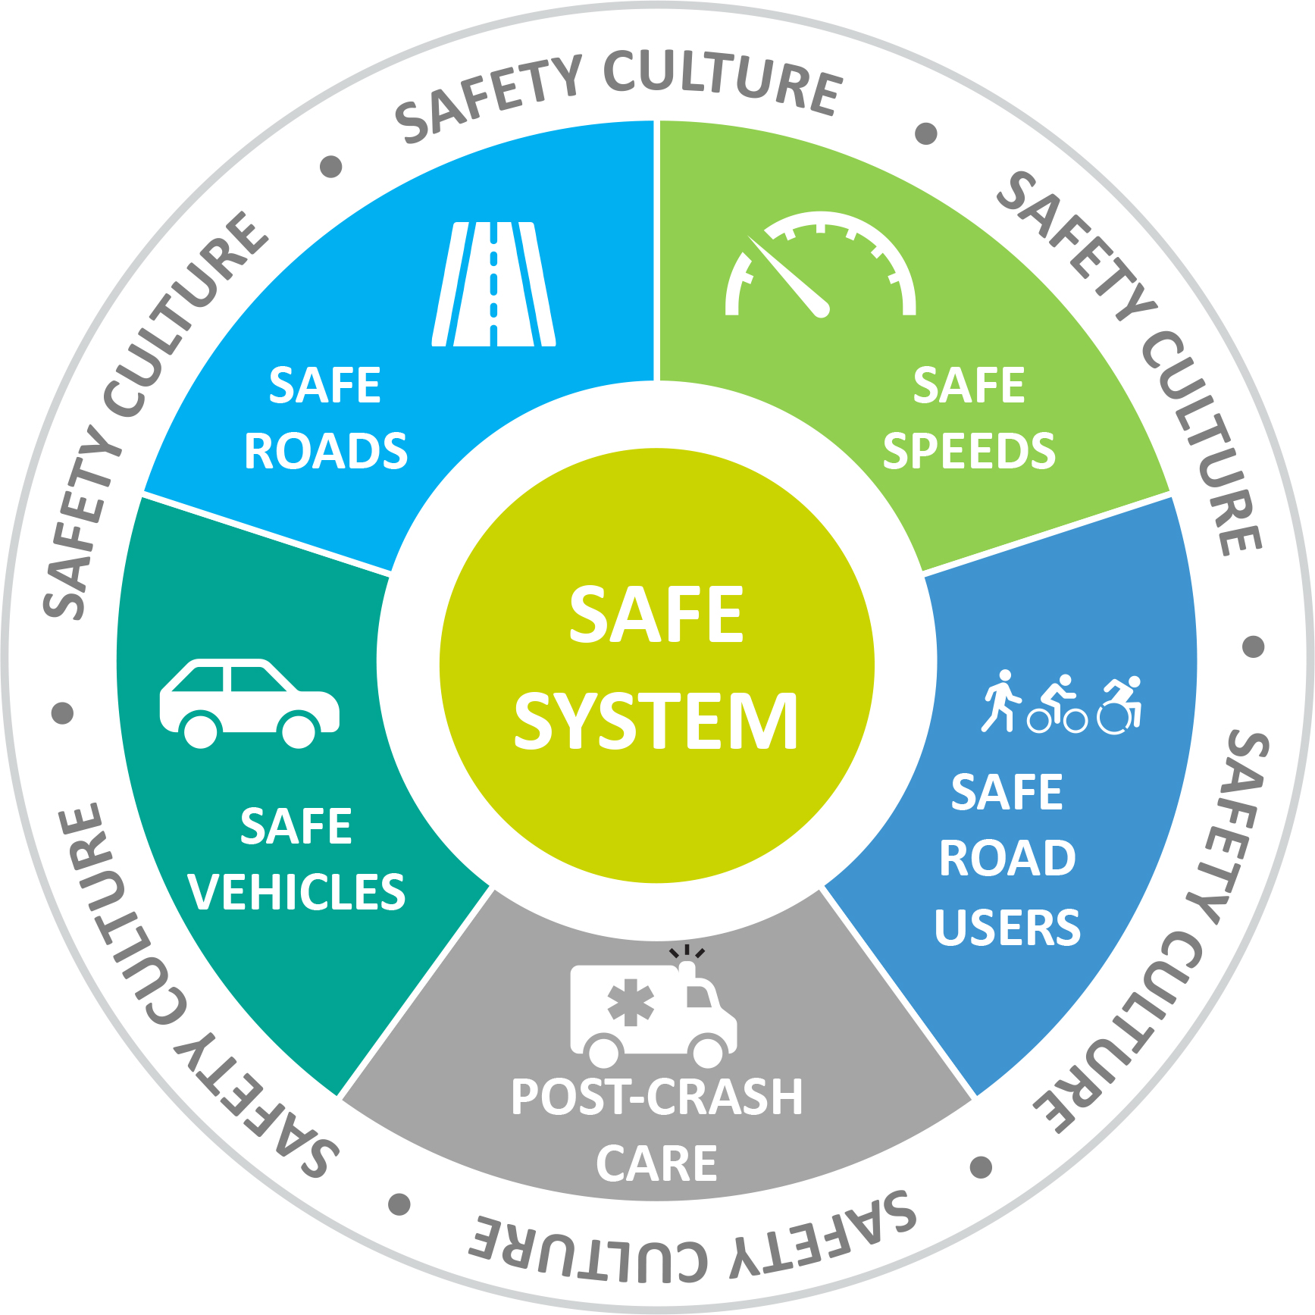
Safe System Approach
1. Intervene Upstream
2. Anticipate Error
3. Reduce Energy

Slide 31
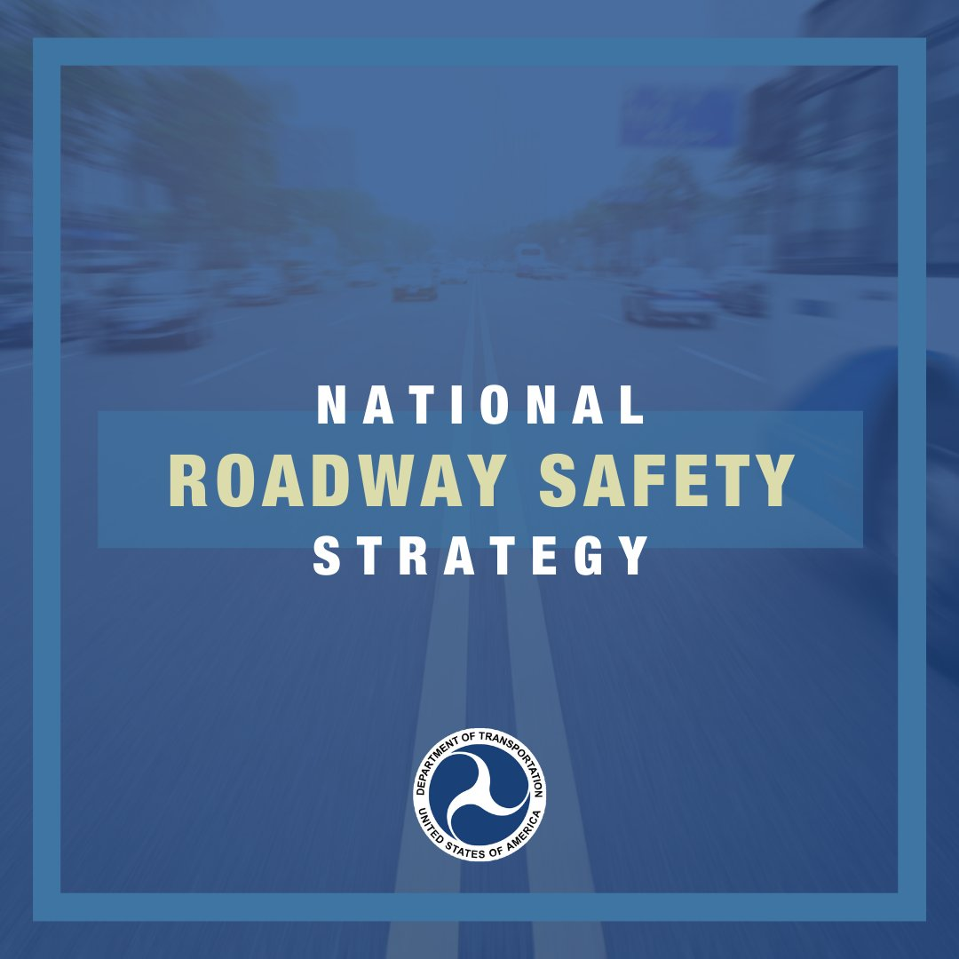
Federal Direction
Implementing the Bipartisan Infrastructure Law

Slide 32
Looking for upstream solutions…

Slide 33
Opportunity
Safe Streets and Roads for All
$1 billion per year for communities
https://www.transportation.gov/grants/SS4A

Slide 34
